Slide 1
Fall 2023 Senate Retreat
Welcome Senators, Department Chairs, New Faculty and Guests!

Slide 2
Agenda
Call to Order and Welcome
Land Acknowledgments
New Faculty Introductions
Retreat Overview
  IdeazBoard
Meet Your New Senate Officers
Senate Committee Updates
  Curriculum and Instruction Council
  Distance Education Advisory Group
  Intersectionality, Race, and Social Justice Advisory Group
Information/Discussion
Announcements

Slide 3
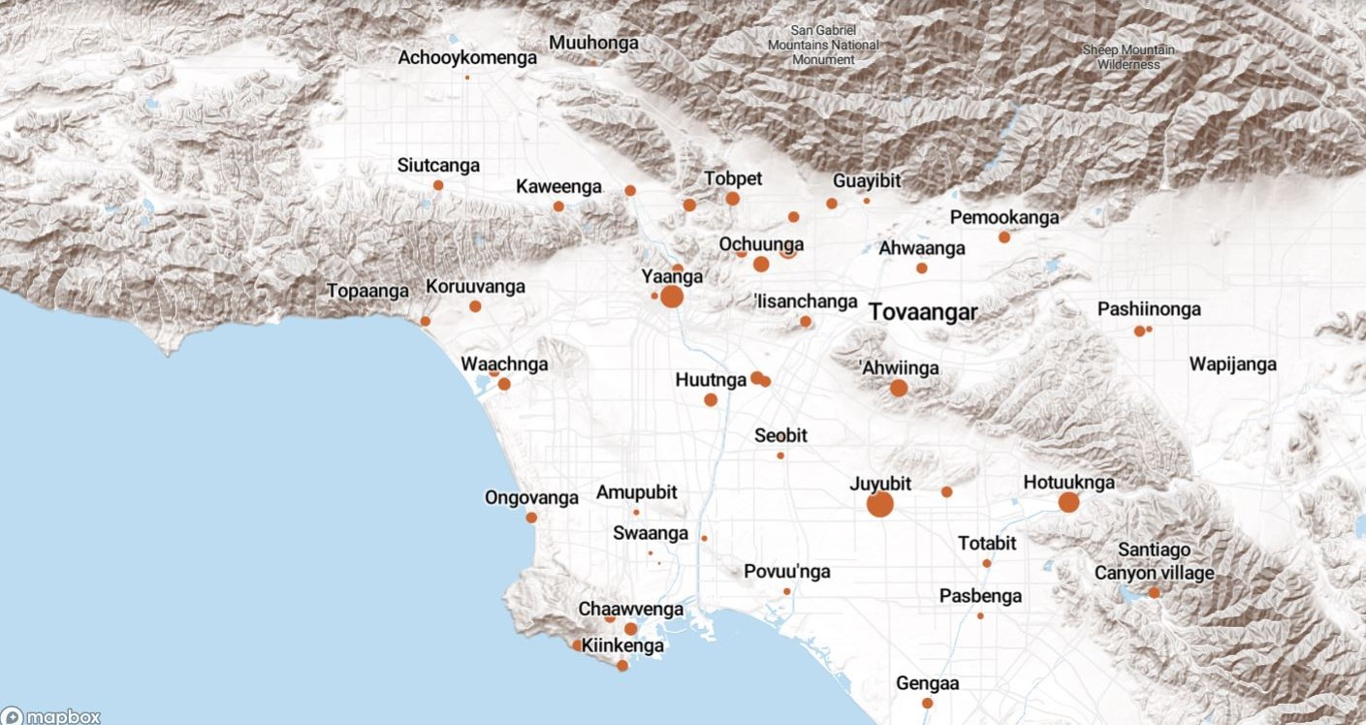
Land Acknowledgement
We acknowledge that the land on which Santa Ana College exists today is the ancestral land of the Tongva people, whose presence and resilience in Santa Ana continues to this day. We take this opportunity to honor the original caretakers of this land and recognize that histories of land theft, forced removal and assimilation, genocide, and erasure, and settler colonialism that have brought our institutions and ourselves here.
To acknowledge is not enough. This land acknowledgement is additionally a call to act, to consider our positionality and complicity in relations to these forces, and to engage in relationships and solidarity with the Tongva and other indigenous peoples.

Slide 4

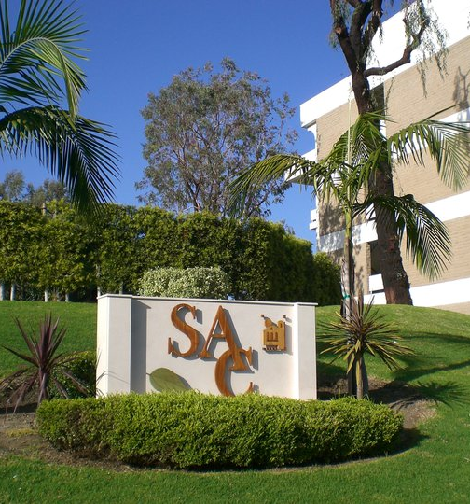
Meet Our New Colleagues
Jeanell Allenegui Parayno
Bassam Ayoub
Christopher Becerra
Cheryl Bucholtz-Magallon
Michael Busch
Julian S. Camacho
Veronica Castaneda
Jessica Christensen
Laura Derr
Jaime Gonzalez
Geena Guerrido
Maria Hanson
Paige Henley
Wesley Hillman
Lindsay Kapp
Robin Leafblad
Michael Levine
Lisa Macafee
Andrew H. Manson
James Martin
Rashida A. Mosley
Anthony James Orona
Tomas J. Ruvalcaba
David Sauber
Kevin Slay
Craig Ursuy
Candice Vazquez
Emily Vu

Slide 5

Retreat Overview
IdeazBoard Questions
What topics/areas would you like to see addressed this semester by the Academic Senate?
Nominations for Fall 2023 At-Large Senators (up to 2 Full-time Faculty and 1 Adjunct Faculty)
For the Good of the Order: Affirmations
Other - Comments/Questions/Concerns
https://ideaboardz.com/for/SAC%20Fall%202023%20Senate%20Retreat/5031842

Slide 6
Vice President of Culture & Engagement: Amberly Chamberlain
Become familiar with the role of AS President, substituting for the position, and even completing the term of Presidency if a vacancy were to occur.
Serve as a co-signer on any Academic Senate bank account transactions.
Attend all Academic Senate and Senate Executive Team meetings, communicating weekly with the other Academic Senate officers.
Serve on the following committees, groups & taskforces:
  Professional Development Committee (Tri-Chair)
    Faculty Professional Development Subcommittee (Chair)
    District Gateway Steering Taskforce (Lead)
  Facilities & Safety Committee (Voting Member)
  Intersectionality, Race, & Social Justice Advisory Group (Member)
  SEAP Committee (Voting Member)
  Dual Enrollment, CAP and Enrollment Management Workgroups

Slide 7
Vice President of Culture & Engagement: Amberly Chamberlain
Serve as a liaison for other groups and committees, including but not limited to:
  Curriculum and Instruction Council
  Guided Pathways Core Team
  Institutional Effectiveness & Assessment
  Program Review
Attend College Council meetings as an invited guest from Academic Senate.
Hold regular monthly meetings with Department Chairs.
  Reconvene the Faculty Handbook Workgroup and finalize revisions.
Advise and serve as directed by the President and the Academic Senate, performing other duties as assigned by the Senate Executive Team or the Academic Senate.

Slide 8
Vice President of Community Operations:
Merari Weber
Collect all assessments of the Senate (e.g., annual goals, feedback surveys, DEI priorities, etc.)
Manage AS bank account for deposits and distributions for the AS including proposing a budget to AS.
  Report to AS as to the above.
  Two signatures are needed for all substantial changes.
Serve as the Co-Chair of the Faculty Awards Committee
Coordinate review of Senate bylaws, as necessary
Serve as member of one district committee (will be serving in HRC)
Perform duties as assigned:
  As of now, support this AS retreat with scheduling of facilities, catering
  Support in sending out updates on status of faculty dues

Slide 9
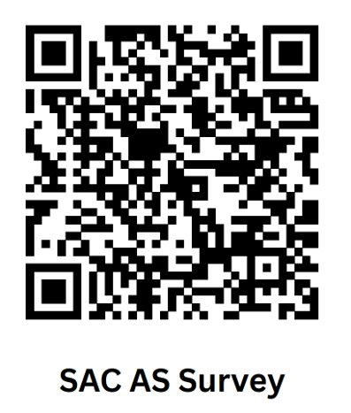
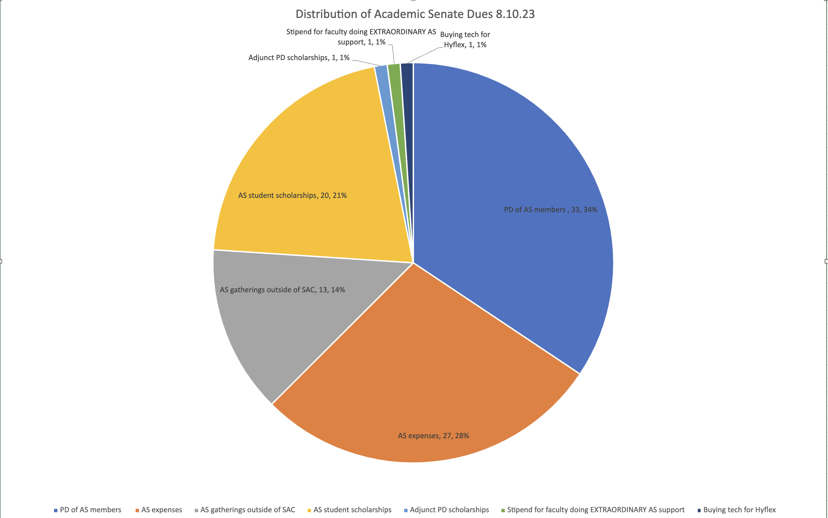
How should your dues be spent?

Slide 10
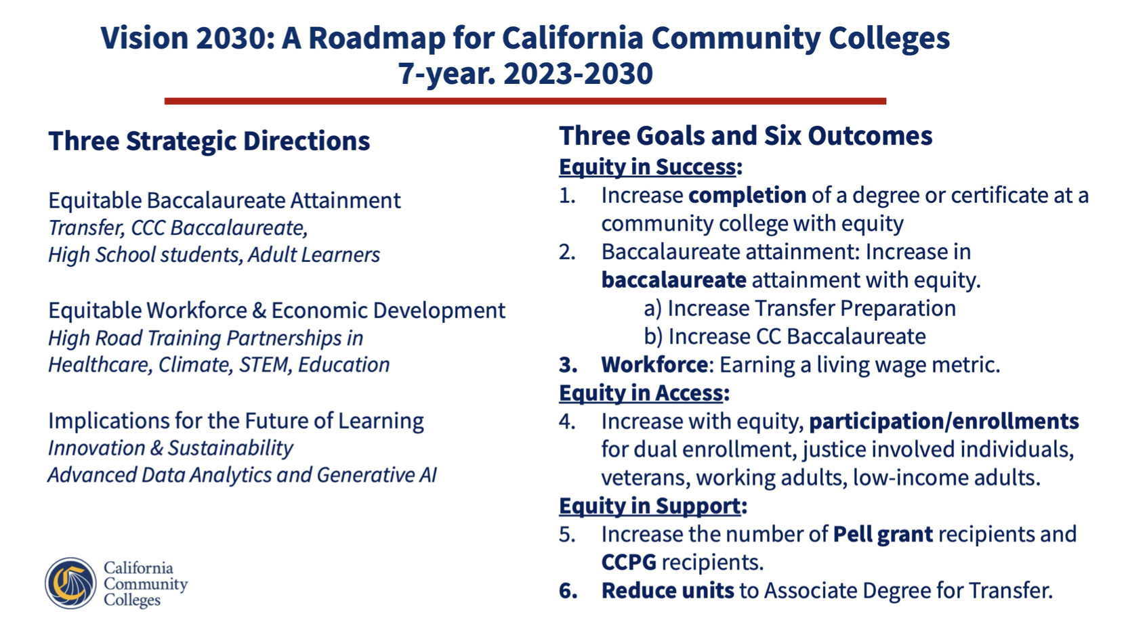
August 2 – Chancellor's Webinar Series

Slide 11


Slide 12
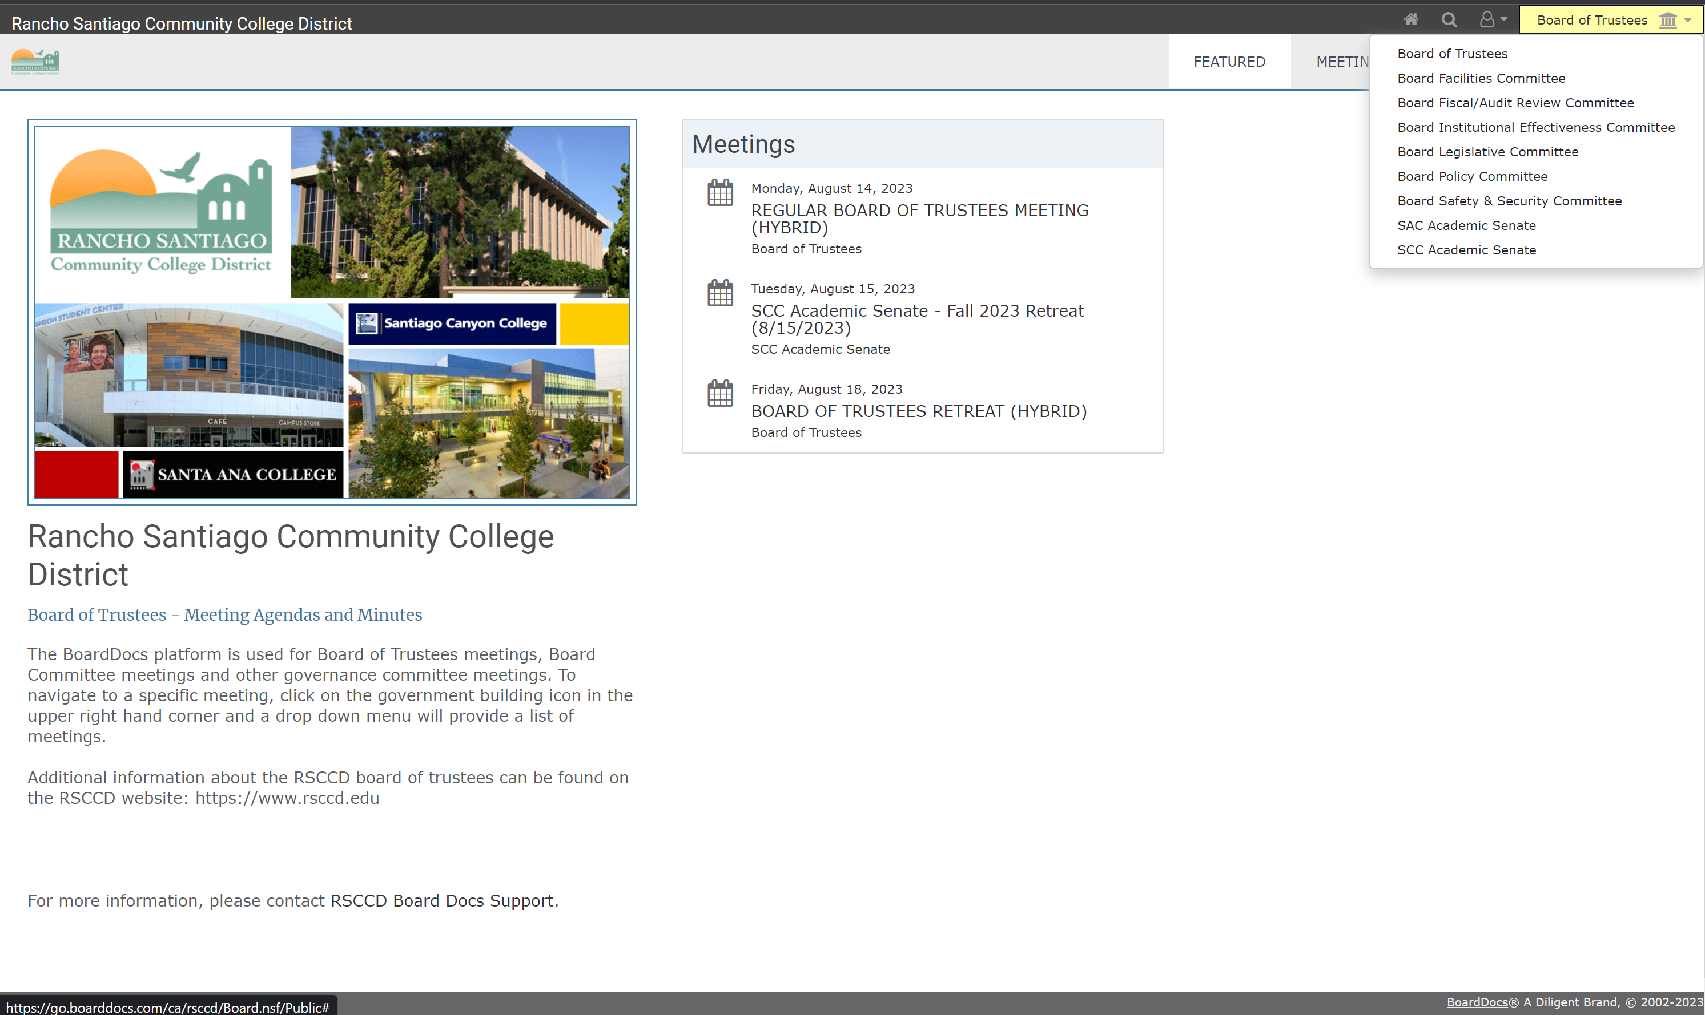
Historian: Andrew Barrios
BoardDocs

Slide 13
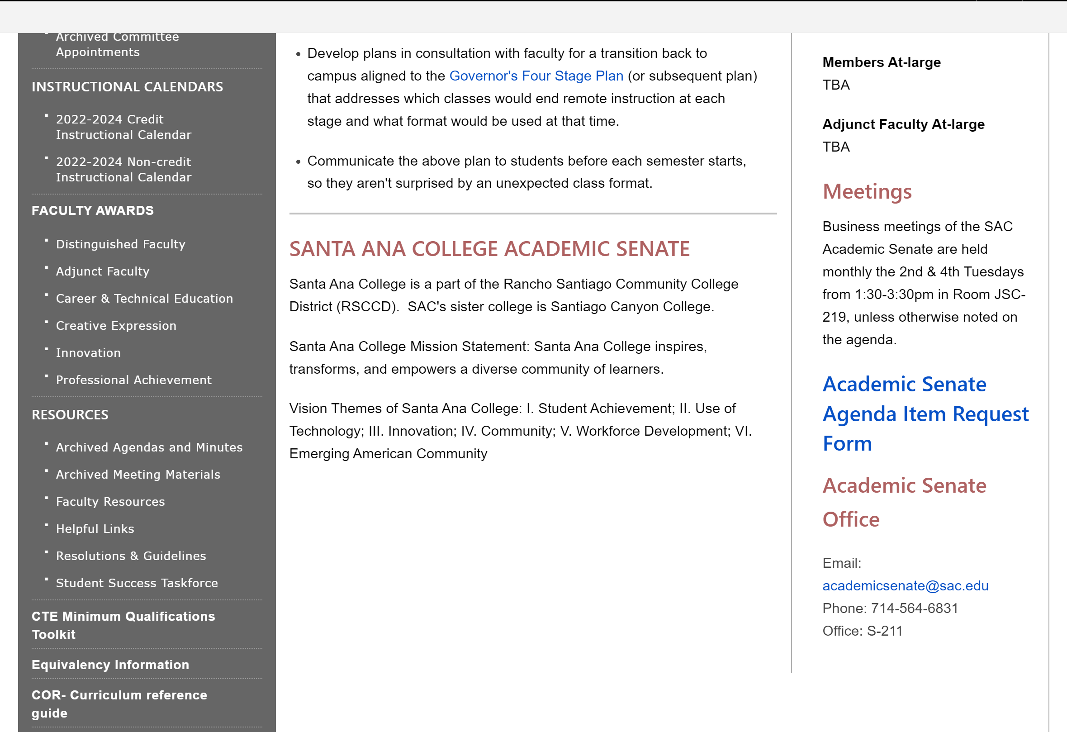
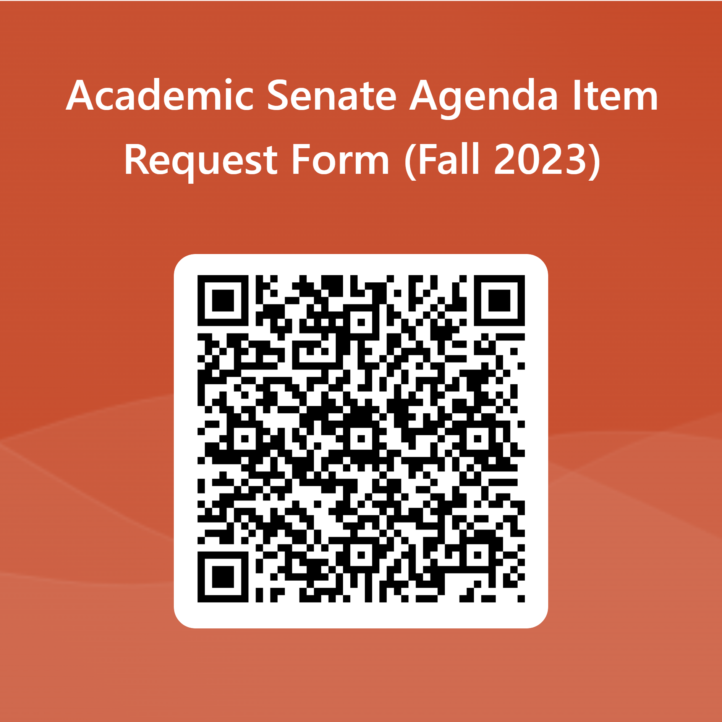
Historian: Andrew Barrios
Agenda Item Request Form

Slide 14
Curriculum & Instruction Council Update:
Madeline Grant
Statewide Updates from Curriculum Institute
  AB 928 - Cal GETC
    Agreement by December 31, 2023
    Planning & Preparation by Fall 2024
    Implementation by 2025-2026
  AB 1111 – Common Course Numbering
    Original Goal to implement 2024-2025 Catalog
    New Goal December 2023 – AB1111 Taskforce will finalize implementation plan
    January 2024 – work within new governance structure to determine implementation details
  Cooperative Work Experience update to Title 5
    Title 5 Updates should be confirmed by the legislature the end of August 2023
    Significant changes and opportunities
    Will require updates to CORs – Fall 2023

Slide 15
Curriculum & Instruction Council Update:
Madeline Grant
Curriculum Office
  New Faculty – please request access to Meta from Anh-Phuong (APT) & Reyes and include the department & division the faculty are assigned to.
  APT & Reyes – available to attend Division Curriculum meetings to provide support & answer questions. Please email them to schedule.
Certificates of Proficiency (CP) >>> Certificate of Achievement (CA)
  16+ Units must be CA
  8 – 15 Units may be a CA
  Below 8 units CP
Curriculum Review/Creation for 2024-25 Catalog Due Oct 16
  Faculty involved with curriculum will receive emails through Meta with comments or questions that need to be addressed
Updates to Meta
  COR input >>> output digital & pdf Catalog
  New Order List >>>> Program Mapping
CIC Meetings (calendar posted on CIC webpage)
  Technical Committee Review – 2nd & 4th Monday 2:00 – 4:00 on Zoom
  CIC Meetings – 1st & 3rd Mondays 2:00 – 4:00 at SAC & CEC

Slide 16
Distance Education Advisory Workgroup
Jaki King
Updates from Summer 2023
Currently at 99 “Quality Reviewed” courses in the California Virtual Campus. We have 2 currently in the Local Review phase.
    Should have over 100 courses by beginning September 2023.
@One is fully funded through the state and will continue with Professional Development assistance.
The workgroup has created a guidelines document for those going through curriculum review regarding the DE Addendum.
  There will be a PD workshop about this led by Jaki King and TJ Naman on Friday, August 18th at 10:50am over Zoom.
We are looking for DE Workgroup Members. We will be meeting in person once a month and may have some working meetings over Zoom.
  Exact time/place will be determined by August 22nd.
  We would ask that you have knowledge and experience with online education and design.

Slide 17
Summer and Fall 2023 CVC enrollment information:
38 SAC students used the CVC to register for classes outside of SAC, however 27 of those 38 stilled registered for a SAC course.
151 students were / are registered in a SAC class they found through the CVC exchange.
Courses Include:
ACCT 101, 102, 104, 120, 124, 212, & 32 ART 100, 111, 130, 140A, 141, & 162 ASL 110, 111, 116 ASTR 110 BA 103, 179, 188 BIOL 109, 194 BUS 101, 115, & 125 CDEV 107, 112, 210, 221, & 231 CHNS 101 | CHST150 CMPR 112, 114, & 140 CMST 101, 102, 103, & 140 ENGL 101 ENGR 100B, 103, & 183 ENTR 121 ETHN 150 GEOG 102 ITAL 120 KNAC 123 KNHE 101, 103, & 104 | LAW 105 MA 51A MATH 140, 150, 180, 185, 219, 280, & 287 MUS 101, 103, & 161 NUTR 115 PHIL 106 & 110 PHOT 150 PSYC 100, 170, & 200 SOC 100 SPAN 101, & 201

Slide 18
Intersectionality, Race, and Social Justice (IRSJ) Advisory Group
Annie Knight and Steve Bautista
Purpose
  To provide leadership and recommendations on practices, policies and procedures that support Diversity, Equity, and Inclusion (DEI) and anti-racism initiatives.
  In collaboration with all community stake holders, this advisory group strives to proactively create and support DEI and anti-racism change impacting faculty.

Slide 19
Intersectionality, Race, and Social Justice (IRSJ) Advisory Group
Annie Knight and Steve Bautista
Goals
Discover and learn to operate and lead in ways that promote a campus climate that aligns with our anti-oppression resolution. This includes examining not only the individual/collective behaviors but also faculty structures, bylaws, and culture.
Increase faculty self-awareness in order to understand experiences of colleagues and address past instances of offensive behavior within leadership structures and how to proceed moving forward.
  Specifically, this includes the need to name and identify examples of sexist, racist, and other forms of offensive/oppressive behavior and put into place best practices to eliminate, prevent, eradicate them moving forward (i.e. making recommendations of topics for the Courageous Leadership Institute, etc.).
Demonstrate the skills and knowledge to be able to facilitate inclusive/safe meetings including facilitating difficult conversations by identifying the nuances, managing emotion, observing verbal and non-verbal communication, with the goal to eradicate racism, sexism, and other forms of oppression from our meeting spaces and institution.

Slide 20
Intersectionality, Race, and Social Justice (IRSJ) Advisory Group
Annie Knight and Steve Bautista
Get Involved!
Monthly meetings during fall and spring semesters
  Fall meeting times TBD
Ideally, those interested in joining are personally committed to and invested in DEI and anti-racism work.
Contacts
IRSJ Representatives:
    Steve Bautista (bautista_steve@sac.edu)
    Annie Knight (knight_annie@sac.edu)

Slide 21
Break Time!
Be sure to post your thoughts on goals and topics to cover this semester

Slide 22
What is Equivalency?
Minimum Qualifications (MQ’s) for a discipline is the minimum level of academic, university-level preparation that qualifies a person to teach a course. For example, to teach Chemistry the MQ’s are:
Master’s in chemistry OR Bachelor’s in chemistry or biochemistry AND Master’s in biochemistry, chemical engineering, chemical physics, physics, molecular biology, or geochemistry OR the equivalent.
Equivalency to the minimum qualifications means that a person’s qualifications are equivalent to the qualifications listed in the disciplines list.

Slide 23
The Disciplines List
The list of all MQ’s maintained by Academic Senate for California Community Colleges (ASCCC)
The disciplines list is the connection between classes and the qualifications needed to teach those classes.
Disciplines fall into two main categories.
  Master’s required
  Master’s not required

Slide 24
The Disciplines List
On the SAC senate web site under
“Equivalency Information”
OR
The ASCCC web site
https://www.asccc.org/disciplines-list
Click on:
“Minimum Qualifications Handbook”

Slide 25
Preparing an Equivalency Request
Form I
Form II
Supporting Documentation
https://sac.edu/AcademicSenate
  Scroll Down to Equivalency Information

Slide 26
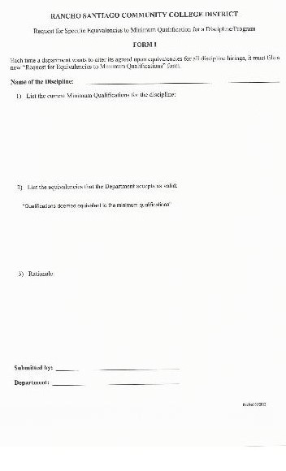

Slide 27
Form I
Form I is used to set the district-wide criteria for equivalency
  This is where you can list additional qualifications that you deem equivalent to the MQ’s
Not used for a specific person
Requires consultation with SCC if they have a corresponding program
  Allow time for consultation with SCC
  All discipline faculty signatures need to be gathered before the senate signatures

Slide 28
Form I
Needs to be updated periodically
Every discipline should have one that is approved and on file with P&C (HR)
Approved Form I’s may be found on the H: drive, “Public”, “Academic Senate”, “Approved Equivalency-Form 1’s”
Include a copy as part of the supporting documentation for an equivalency request for an individual person (Form II)

Slide 29
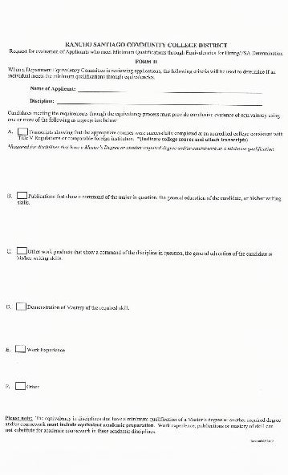

Slide 30
Form II
Equivalency request for a specific person
Supporting documentation should include a copy of Form I, resume, transcripts, and anything else that supports the request. Include only documentation that supports the request.
Provide a good rationale as to why this person’s qualifications are equivalent to those listed on Form I

Slide 31
What Constitutes Equivalency?
That depends on the discipline, the judgment of the faculty, and P&C (HR)
Equivalency is a faculty-driven process
CA Ed Code Section 87359
“…the governing board relies primarily upon the advice and judgment of the academic senate to determine that each individual faculty member employed under the authority granted by the regulations possesses qualifications that are at least equivalent to the applicable minimum qualifications…”

Slide 32
What Constitutes Equivalency?
For disciplines that require a Master’s degree, there must be graduate coursework
Work experience cannot completely substitute for a degree
Disciplines that don’t require a Master’s degree typically fall under CTE. Go to ASCCC and search “CTE Toolkit” for more guidance.

Slide 33
Criteria That May Be Considered
University units in a subject area
Alternate degrees
Continuing education units
Licensure
Credentials
Years of Experience
Portfolio
Military Experience/Training
Etc…

Slide 34
Things To Keep In Mind
An equivalency is discipline specific and says that a person is qualified to teach curriculum throughout the discipline
Since an equivalency is discipline specific and NOT course specific, we cannot do single-course equivalencies
We are all required to evaluate an applicant’s equivalence if requested. You can’t say, “We don’t do equivalencies.”

Slide 35
Things To Keep In Mind
Equivalencies are district-wide. Therefore, an equivalency qualifies a person for a full-time tenure-track position at SAC or SCC
When an additional equivalency is given to a full-time tenured faculty member, that faculty member has bumping rights in that FSA based on his/her hire date

Slide 36
Things To Keep In Mind
If a state auditor determines that a person is not qualified to teach in a discipline, the District may be required to pay back all apportionment that was collected for a class(es).
Before you put your signature on an equivalency, ask yourself:
  Does this person have qualifications that are equivalent to my 2+ years of graduate school? If not, don’t sign it.
  For Form II, does the rationale & supporting documentation show a clear connection/equivalence between the person’s qualifications and what is listed on Form I? If not, don’t sign it.

Slide 37
Before you sign an equivalency as a Senator
Verify that the dept chair and other faculty have signed
Verify that supporting documentation is attached
Review the supporting documentation to ensure that it supports the request

Slide 38
Forms I, II, directions and a link to the disciplines list may be found on the SAC Academic senate web site under the “Equivalency Information” tab
Be sure to review/update your Form I. Don’t wait until the last minute.
Good Luck

Slide 39
A look at the law…
September, 1988 AB 1725: California’s community colleges are legally mandated to have participatory governance structures in place
AB 1725 is implemented through Ed Code and Title 5 regulation.
What’s the difference between Ed Code and Title 5 regulation?
Ed Code is the law and Title 5 is the Board of Governors’ interpretation of the law.
Education Code supersedes Title 5 regulations.
Notes:
AB1725

Slide 40
Faculty have the strongest role of the 3 represented groups
Education Code §70902 (b)(7)
“Establish procedures that are consistent with minimum standards established by the board of governors to ensure faculty, staff, and students the opportunity to express their opinions at the campus level, to ensure that these opinions are given every reasonable consideration, to ensure the right to participate effectively in district and college governance, and to ensure the right of academic senates to assume primary responsibility for making recommendations in the areas of curriculum and academic standards.
  TITLE 5 § 53203 – Senate Powers
  Governing Board shall adopt policies delegating authority and responsibility to its Academic Senate.
  Policies in (A) shall be adopted through collegial consultation with the Academic Senate.
  Guarantees the Academic Senate the right to meet with or appear before the board.

Slide 41
The Academic Senate’s “primary function is to make recommendations with respect to academic and professional matters.”
TITLE 5 § 53200
Sections 53200 (c), "Academic and professional matters" mean the following policy development and implementation matters…
What constitutes academic and professional matters?
Notes:
First see the language “academic and professional matters” – not language used in Ed Code

Slide 42
1. Curriculum including establishing prerequisites and placing courses within disciplines
2. Degree and certificate requirements
3. Grading policies
4. Educational program development
5. Standards or policies regarding student preparation and success
6. District and college governance structures, as related to faculty roles
7. Faculty roles and involvement in accreditation processes, including self-study and annual reports
8. Policies for faculty professional development activities
9. Processes for program review
10. Processes for institutional planning and budget development
11. Other academic and professional matters as are mutually agreed upon between the governing board and the academic senate.
The 10+1
https://www.asccc.org/10_1
Notes:
Critical that faculty participate in ALL areas!

Slide 43
Title 5 § 53200 (d): Consult Collegially means that the district governing board shall develop policies on academic and professional matters through either or both of the following:
(1) Rely primarily upon the advice and judgment of the academic senate,
OR
(2) The governing board, or its designees, and the academic senate shall reach mutual agreement by written resolution, regulation, or policy of the governing board effectuating such recommendations
Collegial Consultation

Slide 44
Title 5 § 53200 (d):
(D) Requires procedures for responding to Academic Senate recommendations that include:
1. When rely primarily, the recommendation of the Academic Senate will normally be accepted, and only in exceptional circumstances and for compelling reasons will they not be accepted
Rely Primarily
RSCCD BP2410: Rely Primarily for..
1) Curriculum, including establishing prerequisites and placing courses within disciplines;
2) Degree and certificate requirements;
3) Grading policies;
5) Standard or policies regarding student preparation and success;
8) Policies for faculty professional development activities;

Slide 45
Title 5 § 53200 (d):
(D) Requires procedures for responding to Academic Senate recommendations that include:
2. When mutual agreement and an agreement has not been reached:
-Existing policy remains in effect except in cases of legal liability or fiscal hardship
-Board may act - after a good faith effort - only for compelling legal, fiscal, or organizational reasons.
Mutual Agreement
RSCCD BP2410: Mutual agreement for..
4) Educational program development;
6) District and college governance structures, as related to faculty roles;
7) Faculty roles and involvement in accreditation processes, including self study and annual reports;
9) Processes for program review;
10) Processes for institutional planning and budget development.
In addition to “10+1,” the Academic Senate has other powers as well.

Slide 46
Education Code-More Powers
Section 87359 (b) Equivalency
Section 87360 (b) Hiring Criteria, policies, and procedures
Section 87458 (a) Administrative Retreat Rights
TITLE 5 § 53203 – Even More Powers
(E) Academic Senate may assume responsibilities and perform functions as may be delegated by the Governing Board
(F) Appointment of faculty members to college committees shall be made by the Academic Senate – (requires consultation with CEO or designee)
Other Powers
Notes:
Hiring criteria- HR Committee, looking at revising ARs

Slide 47
1. District Council: Claire Coyne and Appointed Faculty
2. Planning & Organizational Effectiveness (POE): Claire Coyne and Kristen Robinson
3. Human Resources (HRC): Merari Weber and John Zarske
4. Fiscal Resources (FRC): Claire Coyne (co-chair) and Jorge Lopez (co-chair P&B committee)
5. Physical Resources (PRC): Jason Huskey (co-chair Facilities committee) and Appointed Faculty
6. Sustainable RSCCD: Kelvin Leeds and Appointed Faculty
7. Technology Advisory Group (TAG): Jason Sim (co-chair SACTAC) and Appointed Faculty
RSCCD Participatory Governance
District Committees

Slide 48
Participatory Governance Handbook - https://www.sac.edu/committees/Pages/default.aspx
College Council: Claire Coyne, Monica Zarske and Steve Bautista
Planning & Budget: Co-Chair Jorge Lopez, Claire Coyne + 7 faculty representatives
Facility and Safety: Co-Chair Jason Huskey, 6 faculty representatives, 1-2 from Campus Maintenance Sub-committee
Technology Advisory Committee (SACTAC): Co-Chair Jason Sim and 2 faculty
RSCCD Participatory Governance
SAC Committees

Slide 49
Student Equity & Achievement Program (SEAP):Co-Chair Chantal Lamourelle + 14 faculty
Professional Development Committee: Tri-Chair Amberly Chamberlain (PD Faculty Coordinator), 4 Faculty (1 SAC, 1 SCE, 1 Adjunct & 1 Student Services)
Institutional Effectiveness & Assessment Committee (IE&A): Faculty Co-Chair and One Faculty Representative from each of these recommended areas (Business, Continuing Education, Counseling, Fine & Performing Arts, Humanities, Human Services, Kinesiology, Library, Mathematics, Health Sciences, Sciences, Social Sciences, Student Services, and Technology
RSCCD Participatory Governance
SAC Committees

Slide 50
Enrollment Management Subcomittee: Membership list has not been updated to reflect changes approved last semester.
Are you serving on a SAC Governance Committee or Sub-Committee?
Membership needs to be updated
Senators: Please reach out to your Division/Department faculty this week and look for an email by end of this week to provide the names of faculty who are continuing their service on a PG Committee.
Thank you to those who responded to the poll and shared their interest in serving on a committee. Once vacancies are determined, you will be contacted. Senators will vote to approve appointments at first Senate meeting.
RSCCD Participatory Governance
SAC Committees

Slide 51
Have a great Fall 2023 Semester!
For those who RSVP’d for lunch
See you at the Hacienda!!
11:45a – 1:30pm​

